Slide 1
VIRAL REPLICATION

Slide 2
Introduction
Replication is to create new, infectious virions that are able to infect other cells of the body or subsequent hosts.
Or is the process by which a virus makes copies of itself.
Replication cycle produces –
Functional RNA’s and proteins
Genomic RNA or DNA and structural proteins.
One-step growth curves are used to study the replication cycle of a virus infection. Ellis & Delbruck carried out this procedure for the first time in 1939.

Slide 3
Multiplicity of infection (MOI) refers to the number of virions that are added per cell during infection.
The burst size is the number of infectious virions that are released per cell.
Eclipse period: represents the amount of time it takes to form infectious virions within the cell. Eclipse is characterized by the incapacity to detect free virions since viruses are actively transcribing and replicating inside the host. The eclipse usually lasts from minutes (bacteriophages) to hours or days (animal or plant viruses).

Slide 4
A susceptible cell has a functional receptor for a given virus. The cell may or may not be able to support viral replication.
A resistant cell has no receptor- it may or may not be competent to support viral replication
A permissive cell has the capacity to replicate virus- it may or may not be susceptible
A susceptible and permissive cell can take up a virus particle and replicate it.
Transfection – Introduction of viral genetic material into permissive cells artificially (abnormal route of entry) and recovery of infectious virus
Infection – Replication of virus through normal route of entry into susceptible cells

Slide 5
The tropism of a virus refers to the specificity of a virus for a particular host cell or tissue.
Viruses will only be able to infect the cells that display the molecules to which their virus attachment proteins bind.
Narrow host range- different host species may lack the cell surface proteins that a particular virus uses for attachment.
Broad host range- viruses can successfully infect multiple hosts, either multiple strains of the same species eg Rabies

Slide 6
Genetic material of viruses
DNA
RNA
ss (parvovirus & circovirus)
ds (All DNA viruses except parvovirus & circovirus)
+ sense
(All except reovirus &
birnavirus)
SS
- sense
RNA-dependent RNA polymerase
(some viruses have segmented genome)
dS
(Reovirus & birnavirus)

Slide 7
Location of Replication:
RNA viruses: cytoplasm except retrovirus and orthomyxovirus;
DNA virus: nucleus except poxvirus and iridovirus.
Enzymes or host functions for initiation of viral replication
A. Normal eukaryotic host cell enzymes for nucleic acid replication:
For mRNA synthesis: DNA-dependent RNA polymerase.
For DNA synthesis: DNA-dependent DNA polymerase.
B. Virus specified enzymes for nucleic acid replication:
Reverse transcriptase (RNA dependent DNA polymerase),
RNA dependent RNA polymerase (RdRp)
DNA dependent RNA polymerase, if the DNA virus replicates in cytoplasm.

Slide 8
Early and late genes
Early: refers to the period of a viral infection before the start of nucleic acid replication.
Late: refers to the period of a viral infection after the start of nucleic acid replication.
Early gene: viral genes expressed before nucleic acid replication; most early genes are enzymes and factors to turn on and off the host functions.
Late gene : viral genes expressed after nucleic acid replication; most late genes are viral structural genes and factors for virus assembly.

Slide 9
Stages of Viral Replication
Phase – I Initiation:This stage is characterized by introduction of genetic material of the virus into the cell
Attachment
Penetration
Uncoating
Phase – II Replication: There is no single pattern of replication. But all make proteins with 3 sets of functions to:
Ensure replication of the genome
Package the genome into virus particles
Alter the metabolism of the infected cell so that viruses are produced.
Phase – III Assembly, Maturation, Release

Slide 10
Viral Replication
The seven stages of virus replication are categorized as follows:
1. Attachment
2. Penetration/Entry
3. Uncoating
4. Replication
5. Assembly
6. Maturation
7. Release
Early phase
Late phase

Slide 11
1. Attachment
Binding of the virus to the host cell.
This interaction is specific: the virus contains a virus attachment protein that adsorbs to a cell surface receptor on the cell
Receptors include cell surface glycoproteins, components of the extracellular matrix and receptors involved in cell signaling and activation.
Eg - sialic acid, heparan sulfate proteoglycans, ICAM-1, CD46, CD4 and certain integrins.
Co-receptors- used by many viruses (these viruses require the presence of two essential molecules).
Initial interaction between the virus and its primary receptor brings conformational change in the virus which exposes a binding site for the coreceptor. eg. HIV-1 virus

Slide 12
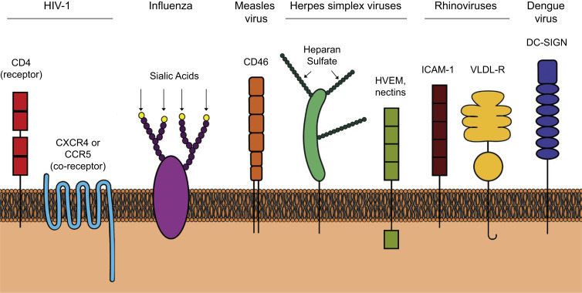
Cell surface receptors.

Slide 13
2.Penetration or Entry
Penetration refers to Entry of entire virion particle or its genetic material into the cell.
Virus cross the plasma membrane without killing the cell.
Mechanisms:
i. Translocation---in some non-enveloped viruses such as FMD virus, the entire virus crosses the cytoplasmic membrane, entering the cell.
ii. Receptor-mediated endocytosis --commonly used by viruses (Both enveloped and non-enveloped) to penetrate the plasma membrane. Most types of viruses use clathrin-mediated endocytosis to enter the cell, like dengue virus, hepatitis C virus, and reoviruses. Virion attachment to receptors, which cluster at clathrin-coated pits, is followed by endocytosis into clathrin-coated vesicles. Vesicles enter the cytoplasm and, after removal of the clathrin coat, fuse with endosomes

Slide 14
Acidification within the vesicle triggers changes in virion proteins and surface structures. The configuration of capsid protein VP4 of picornaviruses, for example, leads to release of the viral RNA from the virion into the cytosol.
Similarly, at the acidic pH of the endosome, the hemagglutinin molecule of influenza virus undergoes a conformational change, which enables fusion to occur between the viral envelope and the endosomal membrane, leading to release of the viral nucleocapsid into the cytoplasm.
iii. Fusion---in most enveloped viruses, such as paramyxoviruses and herpesviruses, fusion of plasma membrane with the viral envelope occurs. This allows the nucleocapsid to be released directly into the cytoplasm.
iv. Injection---in bacterial viruses, only the nucleic acid enters the cell.

Slide 15
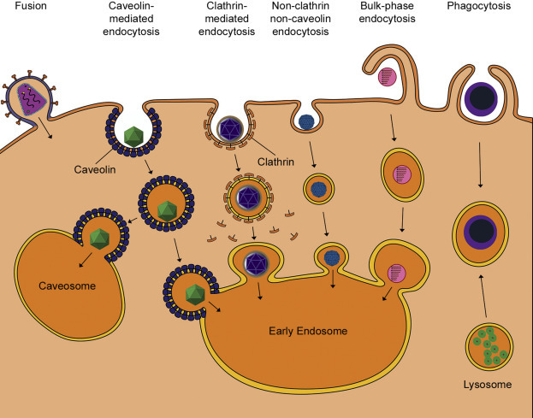

Slide 16
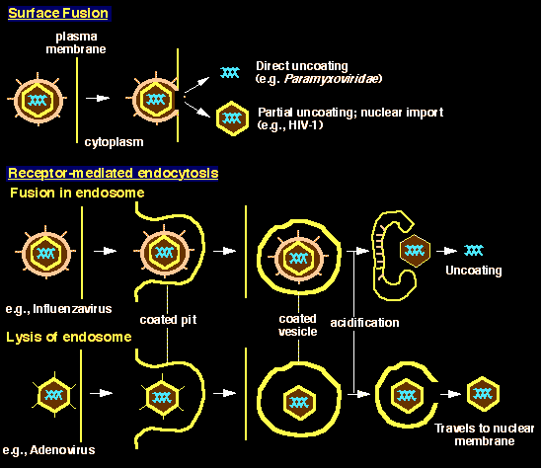

Slide 17
3. Uncoating
Partial exposure or complete release of viral nucleic acids for gene expression or
Breakdown or removal of the capsid, causing the release of the virus genome into the cell to wherever genome replication and transcription will take place.
The lysosomal enzymes play a major role in uncoating.
Different viruses have different mechanisms.
Certain viruses, including rhinoviruses, expand to form pores in the endosome through which the viral genome can escape.
Influenza virus and other enveloped viruses induce fusion of the virion envelope with the endosomal membrane, releasing the viral genome.

Slide 18
Non-enveloped viruses- like adenoviruses- As the endosome acidifies further, the penton base protein is released which trigger endosome lysis leading to escape of the partially disassembled core particle into the cytosol.
Pore formation- Some non-enveloped viruses, such as picornaviruses, form pores in the cell membrane through which the viral RNA is then released into the cytosol.
Lysosomal uncoating- Most viruses which enter the cell via endosomes escape before the endosomes arrive at the lysosome. Except Reoviruses which rely on enzymes found in lysosomes (proteases) to carry out their uncoating. The lysosomal proteases convert the reovirus particle into an infectious subviral particle (ISVP) with partial intact capsids which then penetrates the cytosol.

Slide 19
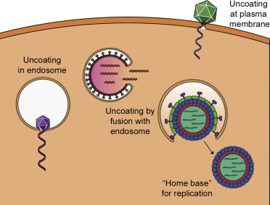

Slide 20
4. Replication
Once uncoating has taken place, synthesis of viral NA starts. This occurs as three different stages with differences between different families of the viruses.
Early transcription and translation: The proteins derived from this stage is mostly the enzymes required for virus replication.
Replication of Nucleic acid: making copies of genome
Late transcription and translation :The proteins produced during this stage are structural proteins and other proteins involved in assembly, maturation, and release from the cell.

Slide 21
5. Assembly
Viruses are created from newly synthesized components, and to be released from the cell, those components must be collected at a particular site of the cell and undergo assembly to form an immature virus particle.
Assembly can often occur alongside maturation and release.
The location of virion assembly will depend upon the particular virus.
Most non-enveloped DNA viruses assemble their nucleocapsid in the nucleus. Viral proteins are imported through nuclear pores to reach the site of assembly.
DNA viruses with envelopes derived from the plasma membrane usually assemble there.
Most RNA viruses assemble in the cytoplasm.

Slide 22
6. Maturation
Final changes within an immature virion that result in an infectious virus particle.
Structural capsid changes often resulting from specific cleavage of capsid proteins to form the mature products, which frequently leads to a conformational change in the capsid, or the condensation of nucleoproteins with the genome and these can be mediated by host enzymes or virus-encoded enzymes.
For eg cleavage of HA proteins of influenza virus by cellular proteases.
For some viruses, assembly and maturation are inseparable, whereas for others, maturation may occur after the virus particle has left the cell.

Slide 23
7. Release
Virion released into the extracellular environment, where it can continue the cycle of infection with new cells.
By budding- Enveloped viruses acquire the lipid membrane as the virus buds out through the cell membrane. Virion envelope proteins are picked up during this process as the virus is extruded. Budding may or may not kill the cell.
By exocytosis-Viruses can bud from any of the membrane systems within the cell, including the rER, Golgi complex, or even the nuclear envelope. These viruses are not released by budding but it generally undergoes exocytosis to leave the cell.
Non-enveloped viruses can also exit the cell via exocytosis.
Lytic viruses- most NE viruses disrupt the plasma membrane and cause the lysis, or bursting, of the cell. This releases the nascent virions to infect new cells.

Slide 24
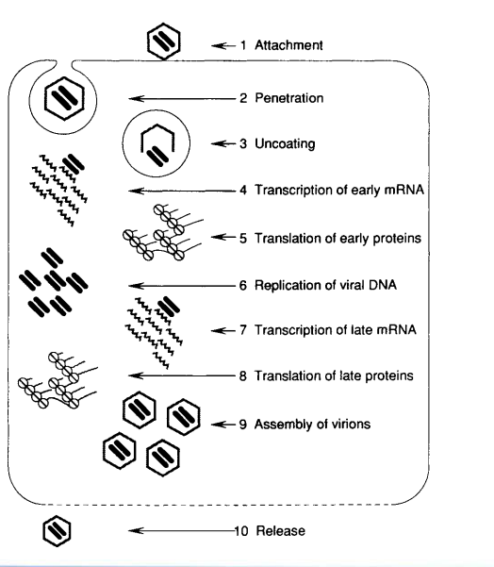

Slide 25
Replication of DNA viruses
Location: nucleus.
Use host DNA-dependent RNA polymerase for transcription.
The majority of poxviruses and iridoviruses have virion-encoded transcriptases that allow them to replicate in the cytoplasm.
Replication of viral DNA is semi-conservative and symmetrical with both strands being replicated.
Host DNA polymerases may be involved in replicating small- to moderate-sized genome viruses (papillomaviruses, polyomaviruses), whereas larger sized genome viruses usually code for their own polymerases (adenoviruses, herpesviruses, poxviruses).
Viruses with no DNA polymerase of their own require actively dividing cells to replicate, since they must use the cellular DNA polymerase eg parvovirus B19

Slide 26
Maturation of DNA viruses, with the exception of poxviruses and iridoviruses, occurs in the nucleus.
Structural proteins are transported from the cytoplasm to the nucleus, where they interact with each other and with the genome and are assembled into capsids that surround the nucleic acid.
Enveloped viruses complete maturation by budding through the nuclear membrane (iridoviruses) or the plasma membrane.

Slide 27
Double-Stranded DNA Virus Replication
Asfarviridae, Poxviridae, Iridoviridae, Herpesviridae, Papillomaviridae, and Adenoviridae
In general, replication takes place in the nucleus by host enzymes (for small viruses such as polyoma and papillomaviruses) or by virus-encoded replicases (adenovirus, herpesvirus).
Replication of poxviruses and some iridoviruses takes place in the cytoplasm resulting in the formation of inclusion bodies, which contain necessary enzymes of viral origin associated with replication, such as viral DNA-dependent DNA polymerases.
The dsDNA may be in the form of circular, linear, circularly permuted, or linear with covalently closed ends.
The small circular genomes replicate bi-directionally in a manner similar to plasmids.

Slide 28
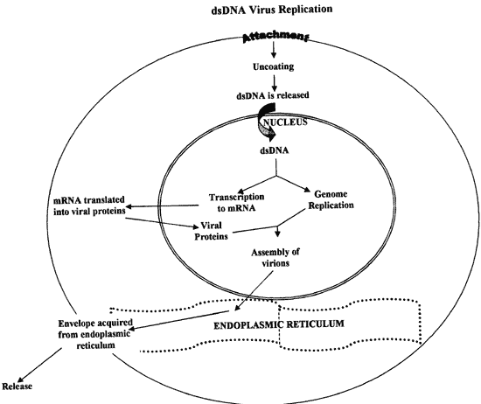

Slide 29
Single-Stranded DNA Virus Replication
Includes Circoviridae and Parvoviridae.
The ssDNA may be in the forms of linear single-component (parvoviridae), circular single-component (circoviruses).
The single-stranded circular DNA of circoviruses replicates by a
rolling circle mechanism.
Replication occurs in the nucleus and involves the generation of a - sense DNA strand to serve as a template for the + sense DNA genome for the progeny virions. This involves the production of a dsDNA intermediate, known as the replicative form.

Slide 30
Entry of the viral ssDNA into the nucleus stimulates its "repair" by host enzymes into the replicative form.
In the case of the circular forms, the replicative form is associated with host histones and other nuclear proteins and thus "treated“ as a host chromosome.
Linear forms have derived mechanisms that allow the genome to be replicated without a loss of DNA following each replication.

Slide 31
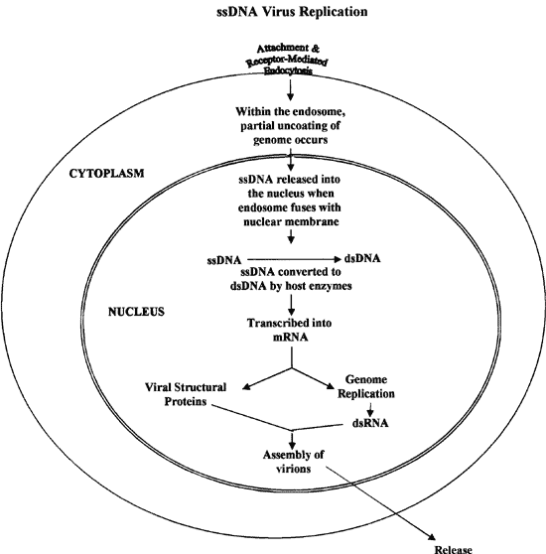

Slide 32
Double-Stranded DNA Viruses with Reverse Transcriptase
Includes the Hepadnaviridae with Genome partially ds non-covalently closed circular DNA,
Following attachment, penetration, and partial uncoating of the virion, the partially dsDNA enters the nucleus and is completed by viral polymerase/ and/or cellular enzymes. Once completed, the backbone is sealed by the action of host ligase.
In the nucleus, the viral DNA acts like a "mini-chromosome" following its association with host histones, etc. However, host DNA polymerase cannot replicate it.

Slide 33
In the replication cycle a large mRNA called the pg-RNA (pre-genomic RNA), which is longer than the DNA template from which it was transcribed due to the addition of a poly A tail is produced. It is this RNA intermediate that serves as the template for the virion DNA.
Smaller mRNAs are also produced, leave the nucleus, and serve as template for translation, giving origin for viral polymerase and capsid protein. Partial assembly of capsids ensues.
Some of the pgRNA is encapsidated into these recently assembled, immature virions.

Slide 34
Within the capsid, a cDNA copy of the pgRNA is made by encapsidated reverse transcriptase (viral polymerase).
Following synthesis of the first complementary cDNA strand, the viral polymerase degrades the pgRNA template and begins synthesizing the second DNA strand.
The virions are then released from the cells by budding, containing a DNA genome that is only partially double stranded.

Slide 35
Replication of RNA Viruses
Replication of most RNA viruses occurs strictly within the cytoplasm of cells
Exceptions are orthomyxoviruses (bunyaviruses) that require factors from host DNA transcription and retroviruses that replicate via a DNA intermediate.
Attachment is an electrostatic interaction between the virions and specific cell receptors.

Slide 36
Viruses then enter the cell by receptor-mediated endocytosis or by fusing with the cell membrane or with the endocytic vesicle (enveloped viruses).
Uncoating occurs in the cytoplasm, or during passage (translocation) through the cell membrane,(picornaviruses).
The RNA of reoviruses, however, is never completely uncoated, but remains in viral cores during genome expression and replication.
The genome of some RNA viruses is a single molecule of RNA (monopartite); in others, the genome is segmented (multipartite).

Slide 37
The RNA of some animal viruses has mRNA function (+ sense) and can be directly translated, whereas the genome in others is antisense (- sense), and must first be transcribed into + RNAs by a viral-encoded RNA-dependent RNA polymerase (transcriptase).
Retroviruses have the enzyme reverse transcriptase (RNA-dependent DNA polymerase) permitting the formation of a dsDNA intermediate (provirus DNA), which becomes incorporated into the host genome, and is subsequently transcribed into mRNA by the host DNA-dependent RNA polymerase.

Slide 38
In general, replication of viral RNA is semi-conservative and proceeds via a replicative intermediate (R1). The R1 consists of parental viral RNA that serves as a template for the transcription of several RNA strands, which eventually "peel off" and serve as templates for the synthesis of viral RNA.
Replication of double-stranded RNA of reoviruses is conservative and asymmetrical; only one strand is replicated, unlike double-stranded DNA. The replication processes requires RNA-dependent RNA polymerases (replicases) that are virus encoded.
Maturation occurs in the cytoplasm with the viral RNA becoming associated with the capsid proteins forming the nucleocapsid. Enveloped viruses complete maturation by budding through the endoplasmic reticulum, Golgi apparatus, or the plasma membrane.

Slide 39
Double-Stranded RNA Viruses
Includes Reoviridae and Birnaviridae.
Attachment is via receptor-mediated endocytosis. The virion is partially uncoated and the core particle remains in the endocytic vesicle (ISVP)
Replication is by a conservative mechanism, the dsRNA serves as a template for the production of mRNA by a viral RNA-dependent RNA polymerase.
Replication does not involve the formation of R1 intermediates. No free dsRNA is formed in the cytoplasm of the host cell.
All have segmented, linear genomes. Each segment corresponds to a monocistronic mRNA.
All of the genomes are linear, but may be two-component (Birnaviridae), or multi-component (reoviruses have 10 – 12 components).

Slide 40
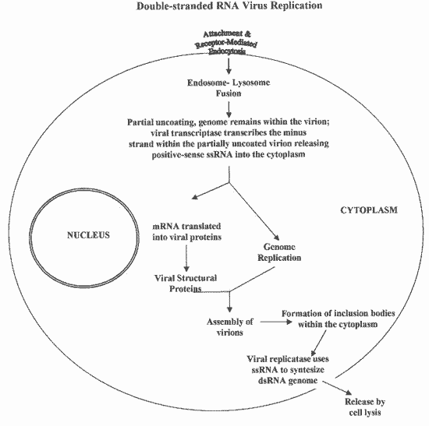

Slide 41
Single-Stranded Positive Sense RNA Viruses
Includes :Caliciviridae, Picornaviridae, Astroviridae, Flaviviruses, Coronaviridae, Togaviridae, and Arteriviridae.
Attachment is via receptor-mediated endocytosis. There, the virion is uncoated and the ssRNA released to the cytoplasm.
The viral genomes that are messenger-sense are totally or partially translated into proteins as the first step of virus replication.
Picornaviruses and Flaviviruses possess a + sense RNA as genome, which behaves as a polycistronic mRNA. The genome is directly translated into one large polypeptide, which is co-translationally cleaved into a number of proteins by viral encoded or host cell proteases.
Coronaviruses have a complex transcription pattern, involving several rounds of translation in order to complete the replication cycle.

Slide 42
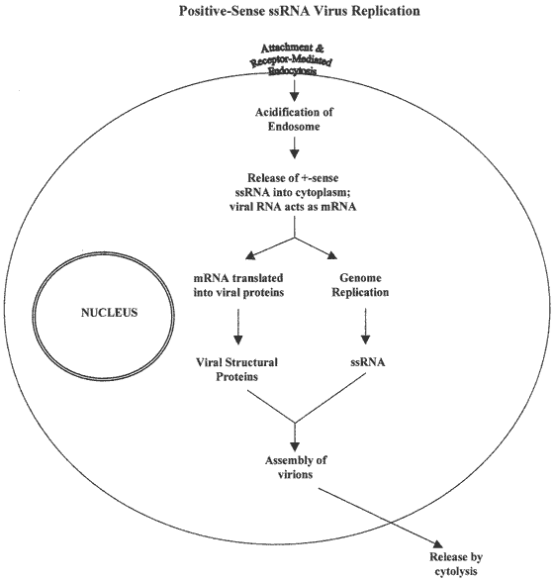

Slide 43
Single-Stranded Negative Sense RNA Viruses
Includes: Orthomyxoviridae, Rhabdoviridae, Paramyxoviridae, Bornaviridae, Filoviridae, Deltavirus, Arenaviridae, and Bunyaviridae.
As the genomes are negative-sense, they are not translated. Therefore, these viruses need to bring their replicases in the virion to proceed with transcription and replication of the genome.
Orthomyxoviruses have segmented genomes. The first step in the replication process is the transcription of – sense RNA by a virus encoded RdRp
Rhabdoviruses have non-segmented genomes. Replication still requires the transcription via a viral RdRp.
In the case of the ambisense viruses, the transcriptase is encoded within the positive-sense portion that will eventually mediate the transcription of the negative-sense regions.

Slide 44
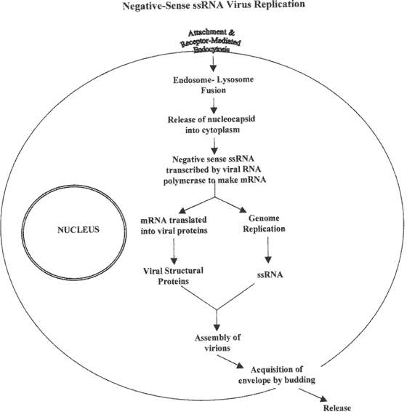

Slide 45
Single-Stranded Positive Sense RNA Viruses with Reverse Transcriptase
Includes the vertebrate-associated viruses in the family Retroviridae having diploid linear ssRNA held together by protein.
It is 5'-capped and has a 3' poly A tail, and has four characteristic coding regions (gag-pro-pol-env)-gag (group specific antigen: matrix protein, nucleoprotein, capsid) genes; pro (protease) gene; pol (reverse transcriptase and RNase-H); and env (envelope, receptor binding) genes.
The conversion of RNA to ssDNA and then to dsDNA is mediated by the viral enzyme reverse transcriptase. The resulting dsDNA, called provirus DNA, is integrated into the host chromosome by the viral enzyme integrase.
Once integrated into the host genome, the viral dsDNA remains latent until "triggered" into active virion production. The provirus is then transcribed into mRNA by cellular RNA polymerase II.

